Slide 1
Model improvement via Webscraping and Textmining
Notes:
Pour changer le logo en pied de page, aller dans AFFICHAGE > Masque > Masque des diapositives : remplacer le logo en place par le logo de votre entité.
Pour éditer la mention de confidentialité, aller dans le menu INSERTION > En-tête et pied de page, et remplir le niveau désiré.

Slide 2
GOAL
Building a basic model predicting the house value with some basic variables of the original datasets
Improving the model
via additional variables from webscraping
and feature generating via textmining

Slide 3
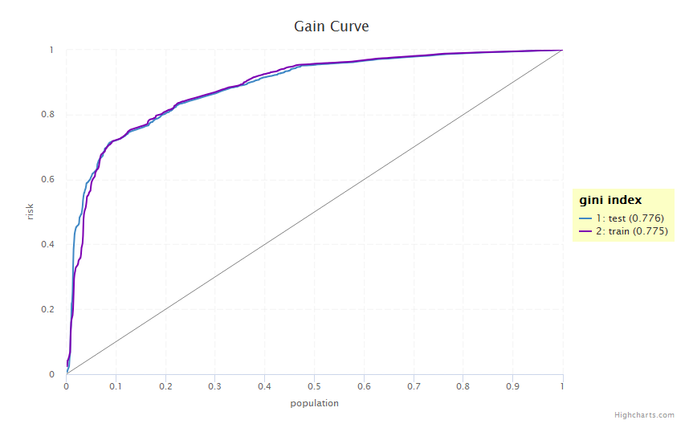
Basic model
Easy GBM model with 4 variables
category
action.type
work.type
status.x
Gini-Index: 77.6%

Slide 4
Webscraping
Scraping the URL in the Code_Violation-dataset for additional information
Using the rvest-package for reading the html code and figuring out some useful information
One problem was that each dataset has ist own webpage so we had to walk through a loop for reading every single page
Got some additional issuance information, i.e.

Slide 5
Text Mining
Two text variables available in two files:
Building permits
Code violation
Using the tm package
Restricted to alpha characters only
Applied stemming methodology to all tokens (words)
Checked spelling using hunspell (an offline package in R) https://www.r-bloggers.com/hunspell-spell-checker-and-text-parser-for-r/
Add one-hot encoded columns related to tokens to the main data base
Modelling using XGBoost gives some improvements compared to only limited variables

Slide 6
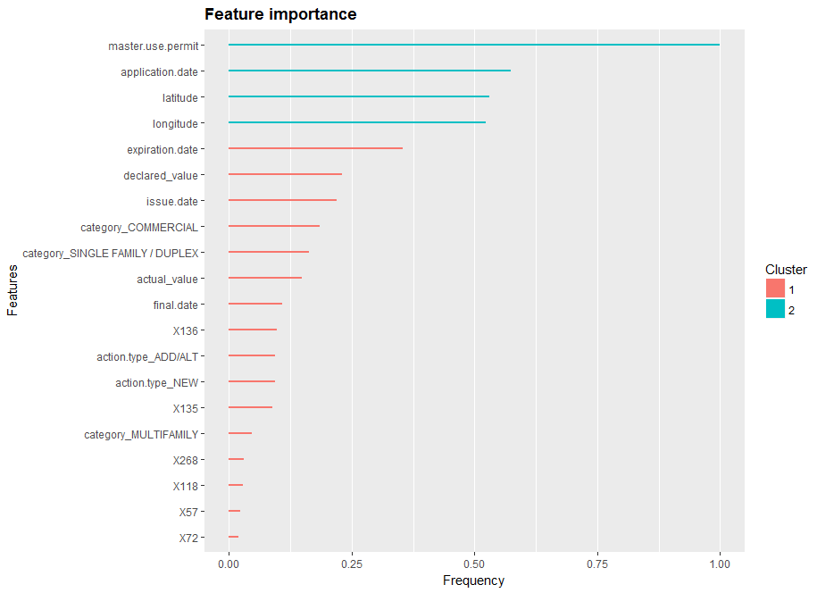
Improved model
~4000 variables
Gini-Index: 83.5 %
The training of the model is very slow, due to the high number of variables

